Slide 1
Discrete Mathematics
Unit 4
4
Counting and Advanced Counting

Slide 2
Basic counting principal
The sum rule:-
If an event can occur in ‘m’ ways and another event can occur in ‘n’ ways, if these two events can not occur simultaneously, then one of the two events can occur in ‘m+n’ ways.
Example 1:
If there are 14 boys and 12 girls in a class, find the number of ways of selecting one student as class representative.
Solution:-
using sum rule, there are 14+12=26 ways of selecting one student(either a boy or a girl) as class representative.
Example 2:
If a student is getting admission in 4 different BIM colleges and 5 BBA colleges, find the number of ways of choosing one of the above colleges.
solution:
using a sum rule, there are 4+5=9ways of choosing one of the colleges.
Product rule:-
If an event can occur in ‘m’ ways and a second event in ‘n’ ways and if the number of ways the second event occurs, does not depend upon the occurrence of the first event, then the two events can occur simultaneously in ‘m.n’ ways.
Notes:
Tushant khatiwada has presented it...

Slide 3
Example 3:
Three persons enter into car, where there are 5 seats. In how many ways can they take up their seats?
Solution:-
The first person has a choice of 5 seats . The second person has a choice of 4 seats. Similarly, the third person has a choice of 3 seats. Hence, the required number of ways in which all the three persons can seat is 5*4*3 =60 ways.
Example 4:
A coin is tossed three times and the outcomes are recorded. How many possible outcomes are there?
Solution:-
Since, each toss of a coin has two faces and so has two outcomes H & T.
So, by multiplication rule, when a coin is tossed three times the outcome is 2 × 2 × 2 = 8.
The subtraction rule:-
If an event can occur in ‘m’ ways and another event can occur in ‘n’ ways, then the total number of ways is m + n minus the number of ways that are common to the two different ways. It is also known as the principle of inclusion-exclusion:
n(A ∪ B) = n(A) + n(B) – n(A ∩ B)

Slide 4
Example:
How many bit string of length eight either start with a 1 bit or end with the two bits 00?
solution:
Use the subtraction rule.
Number of bit strings of length eight that start with a 1 bit: 2⁷ = 128
Number of bit strings of length eight that end with bits 00 : 2⁶ = 64
Number of bit strings of length eight that start with a 1 bit and end with bits 00 : 2⁵ = 32
Hence, the number is 128 + 64 – 32 = 160.
Division Rule:
Suppose there is a procedure that can be carried out in ways and for each way w ,
exactly d of the n ways correspond to the way w
The total number of ways to complete the procedure n/d
Example:
In how many ways can the letters of the word “odd” be arranged?
Total number of alphabet to be arrange(n) = 3
Number of repetition of d = 2
Therefore, Total number of arrangements = $\frac{3!}{2!}$ = 3 ways.

Slide 5
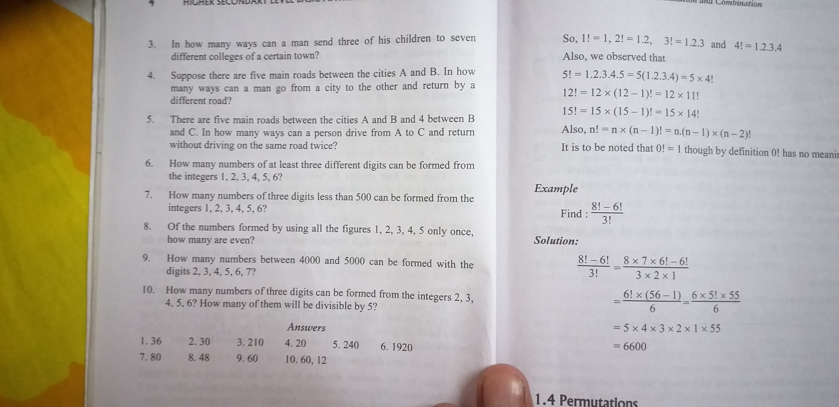

Slide 6
Permutation:
Each of the different arrangements that can be made out of a given number of things by taking some or all of them at a time is called permutation.
Formula :-
The number of permutations(or arrangements) of ‘n’ different things taken ‘r’ at a time (r ≤ n) is denoted by the symbol:
^{n}p_{r} or p(n,r) =
2. Permutations of things, not all different:-
If out of ‘n’ things, ‘p’ are alike of one kind. ‘q’ are alike of second kind, ‘r’ are alike of
third kind and the rest are different. Then, the number of permutations of the ‘n’ things
taken all together is
3. Permutations of things with repetition:-
The number of permutations of ‘n’ different things, taken ‘r’ at a time, when repetitions are allowed is n^{r}.

Slide 7
4. The permutations in a circle are called circular permutations.
The number of circular permutations of ‘n’ different things = (n-1)!
5. The number of different arrangements for n beads in a necklace is
To prove:- ^{n}p_{r} or
proof:
The number of permutation of n deferent things taken r at a time is the same as then umber of ways in which r places can be filled up by n different things.
n
n - 1
n - 2
n-(r-2)
n-(r-1)
…………………
← ways
1
2
3
r-1
r
← places

Slide 8
By the basic principle of counting
the total number of ways in which the r places can be filled up
= n(n- 1) (n- 2) …….to r factors.
= n(n- 1) (n- 2) ……. n- (r-1)
= n(n- 1) (n- 2) …….. (n-r+1)
i.e. p(n,r) = n(n- 1) (n- 2) …….. (n-r+1)

Slide 9
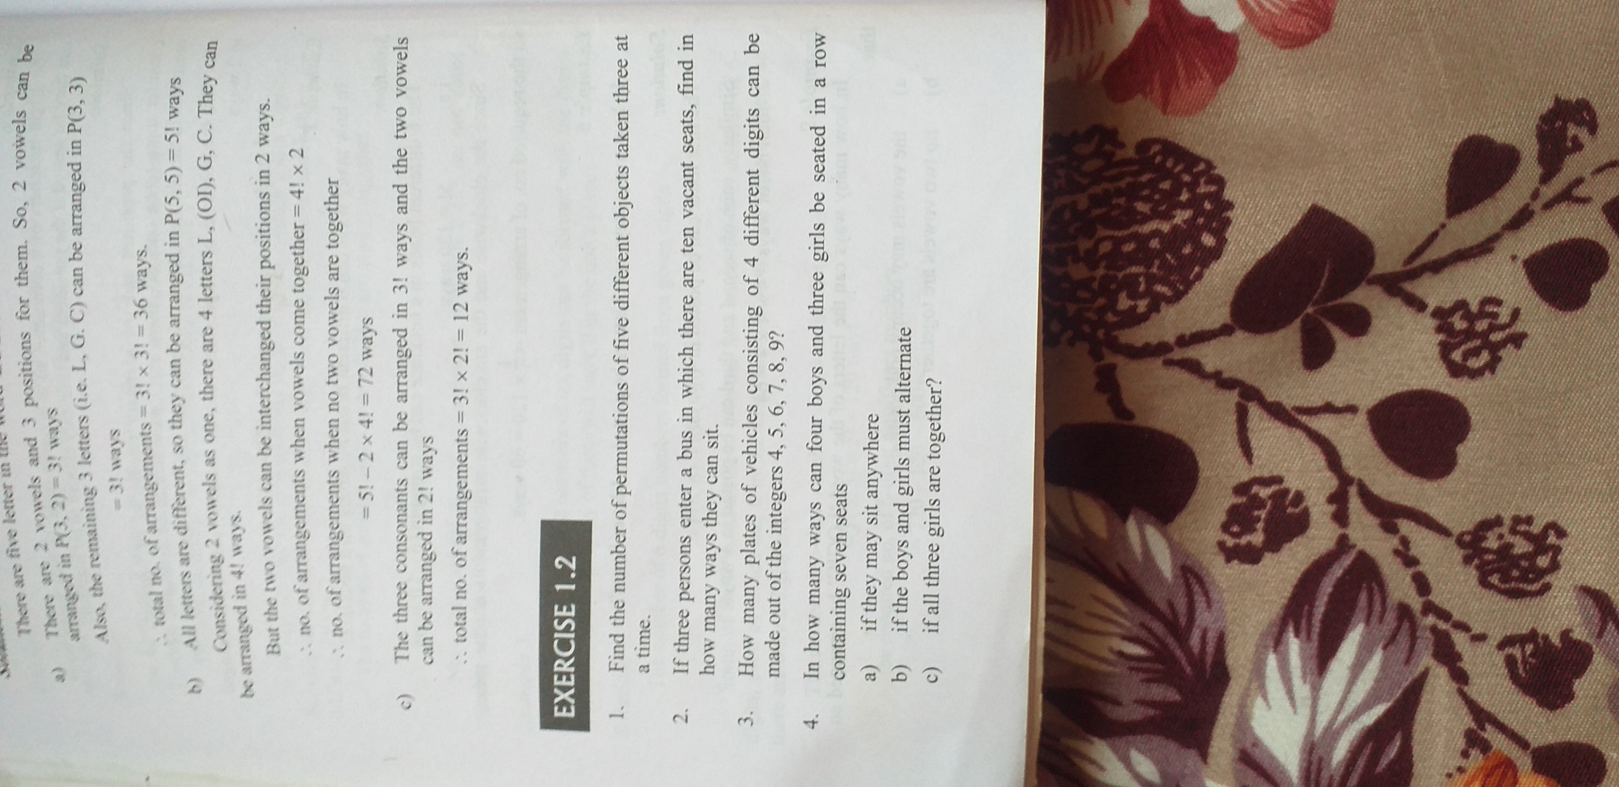
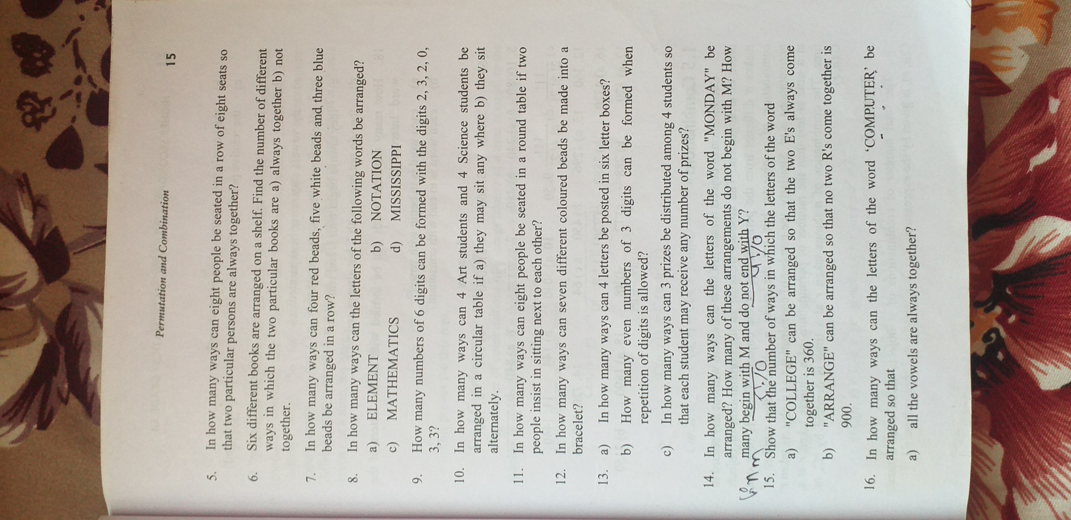

Slide 11
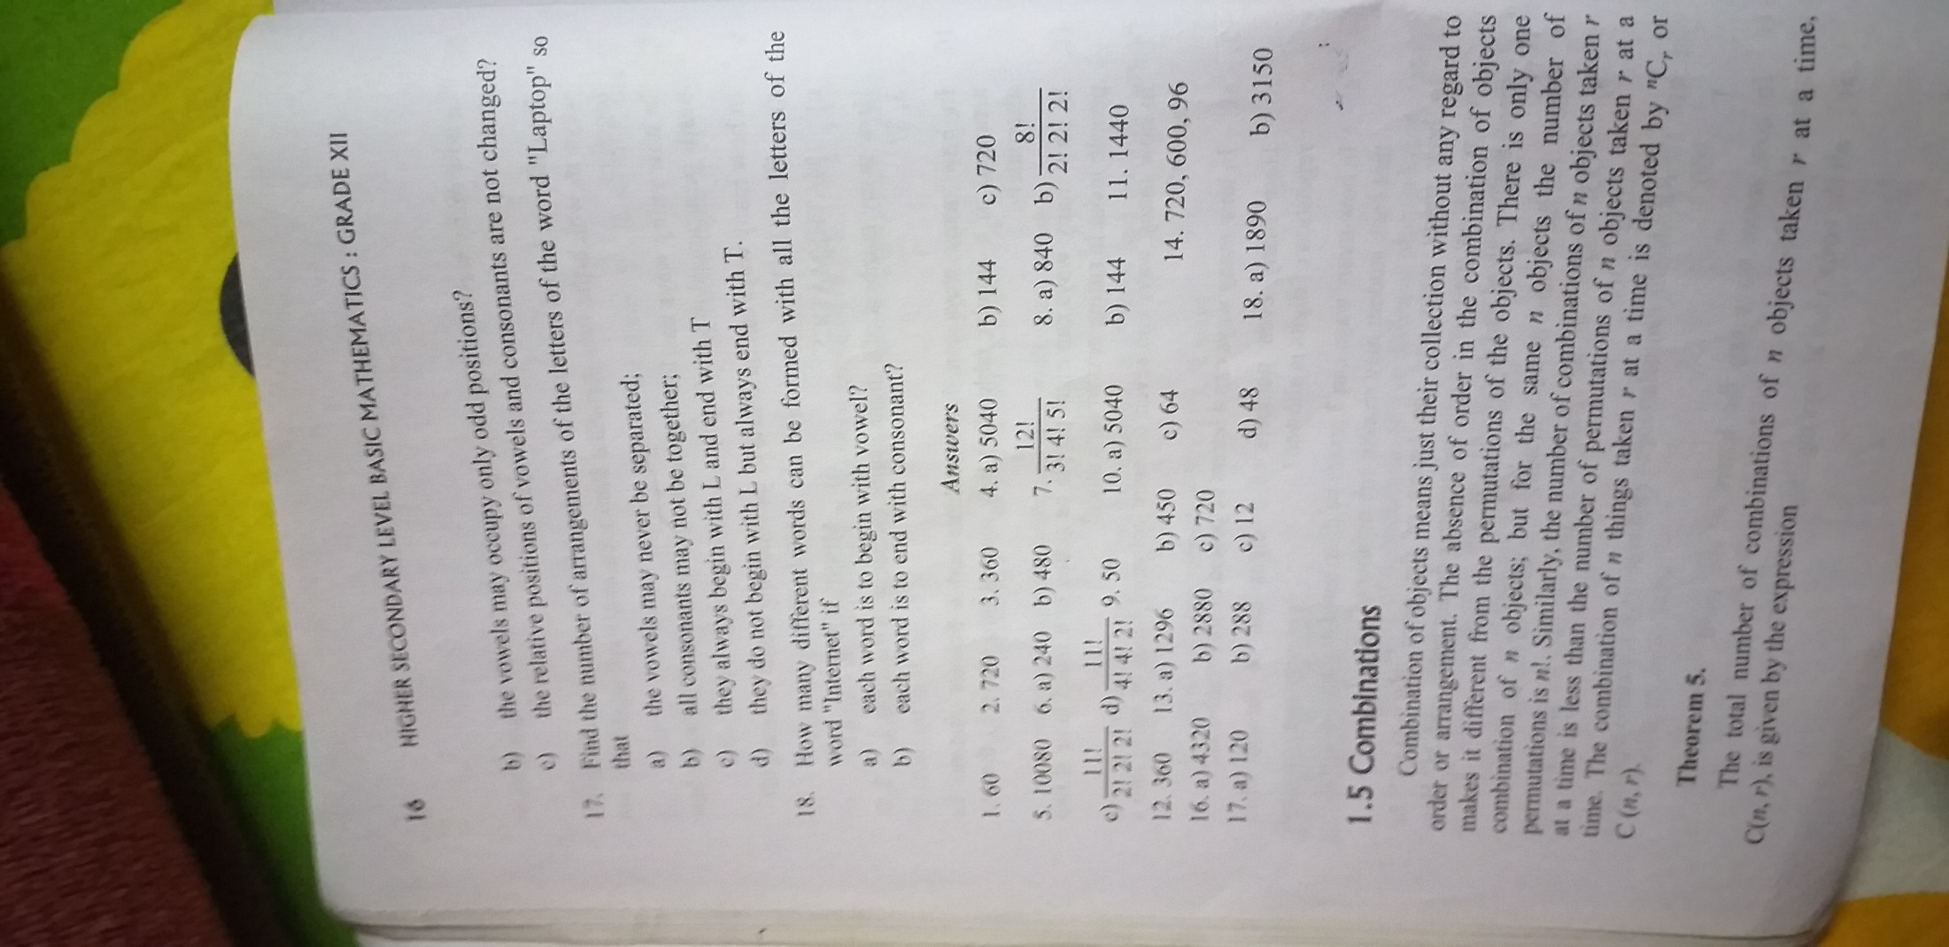

Slide 12
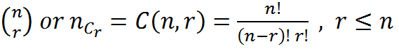
Combination:-
Each of the different selections(or Groups) that can be made out of a given number of things by taking some or all of them at a time is called Combination .
The number of combinations (or selection) of n different things taken r at a time is denoted by the symbol,
To prove: ^{n}C_{r} or
Proof:-
Each of C(n,r) combination contains r different things.
If the r different things are arranged in all possible ways
Each combination will produce r! permutations.
C(n,r) combinations will produce C(n,r).r! permutations
Thus, C(n,r).r! = P(n,r)
or,

Slide 13
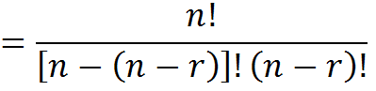
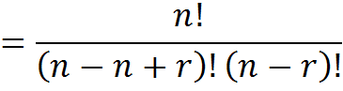
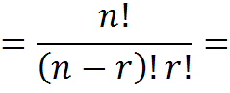
Properties:-
I) ^{n}c_{r} = ^{n}c_{n-r}
R.H.S = ^{n}c_{n-r}
Proof:-
^{n}C_{r} = L.H.S.

Slide 14
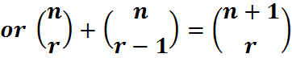
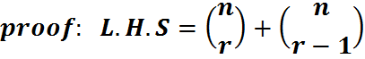
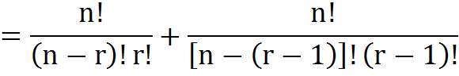
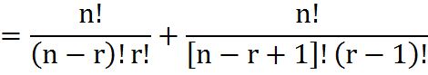
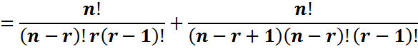
II} To prove Pascal`s identity:
i.e. ^{n}c_{r} + ^{n}c_{r-1}= ^{n+1}c_{r}

Slide 15
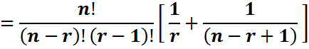
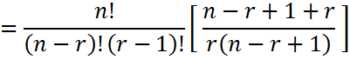
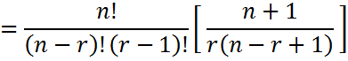
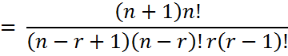
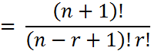
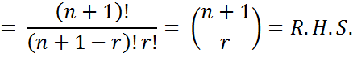
or ^{n}C_{r} = R.H.S.

Slide 16
Restricted Permutations and Combinations
Case 1:- Permutations of ‘n’ things in ‘r’ places when ‘k’ particular objects are always present.
Here ,
The ‘k’ particular things can be arranged in ‘r’ places in p(r,k) ways. The remaining (r-k) places can be filled up by the remaining (n-k) things in p(n-k , r-k) ways.
Hence , The number of arrangements = p(r,k).p(n-k,r-k).
Case 2:-
Permutations of ‘n’ things in ‘r’ places when ‘k’ particular objects do not occur in this case,(n-k) things will fill up ‘r’ places.
So, the number of arrangements is p(n-k,r)

Slide 17
• Case 3:-
Combinations of ‘n’ things taken ‘r’ at a time, when ‘k’ particular things always occur in this case, we keep aside the ‘k’ particular things which always occur. Then we choose the (r-k) things from the remaining (n-k) things.
Hence, the number of combinations is c(n-k, r-k).
Case 4:-
Combination of ‘n’ things taken ‘r’ at a time when ‘k’ particular things never occur.
Here,
The number of combinations is the number of combinations of (n-k) things taken ‘r’ at a time, which is c(n-k, r).

Slide 18
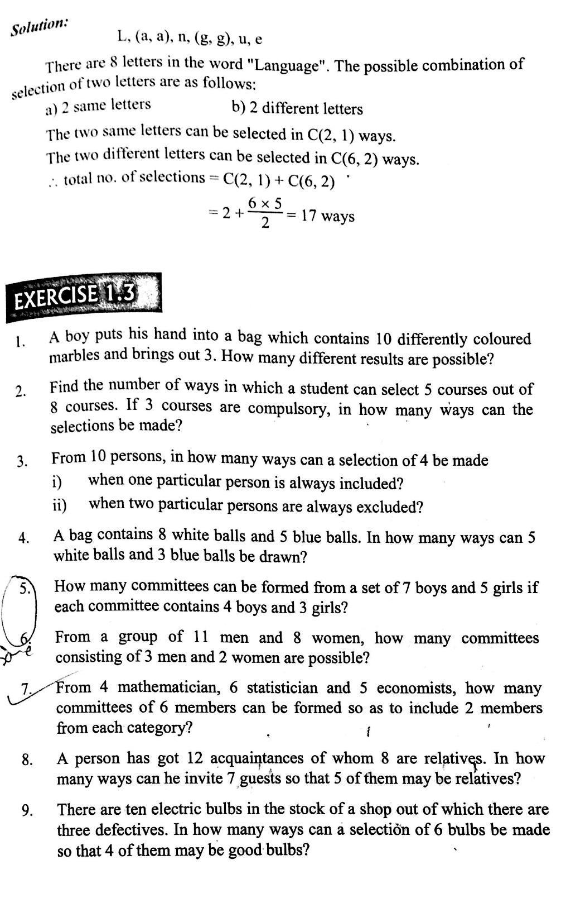

Slide 19
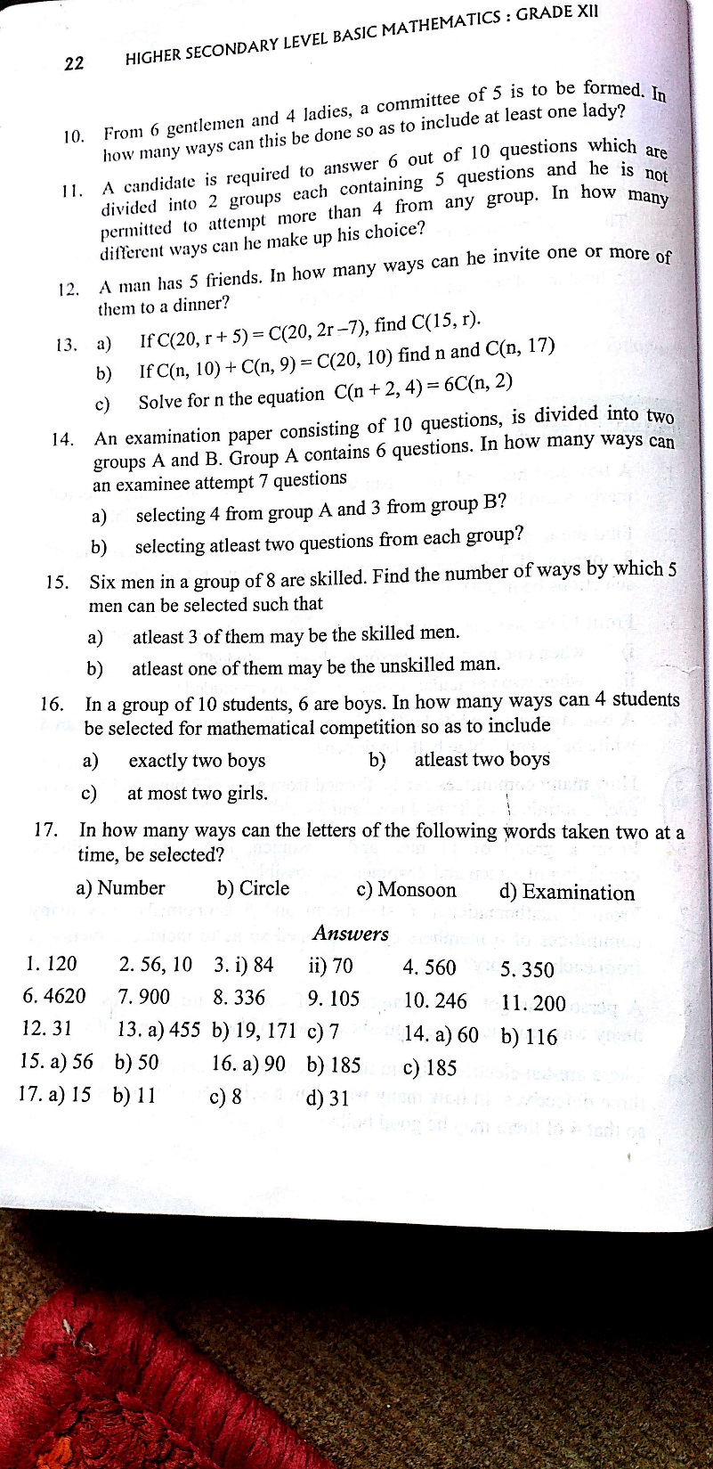

Slide 20
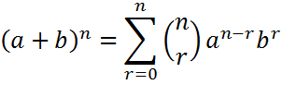
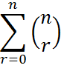
BINOMIAL THEOREM
Statement:-
Let, a , b ϵ R and ‘n’ is a positive integer. Then,
(a+b)^{n} = ^{n}c_{o}a^{n} + ^{n}c₁a^{n-1}b + ^{n}c₂a^{n-2}b² +…….+^{n}c_{r}a^{n-r}b^{r}+…….+^{n}c_{n}b^{n}
where, ^{n}c_{o,}^{n}c_{1,……………..}^{n}c_{n} are known as binomial coefficients.
i.e.
Where,
is known
as binomial coefficients.
General term:-
The (r+1)^{th} term in the expansion of (a+b)^{n} is given by t_{r+1} = ^{n}c_{r} a^{n-r} b^{r} which is called the general term of the expansion (a+b)^{n}.

Slide 21
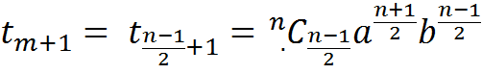
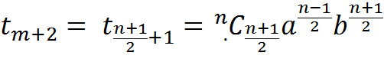
Middle terms:-
Let us consider the expansion of(a + b)^{n}
i} if the power of ‘n’ is odd, say n = 2m+1,then there will be 2m+2 terms in the expansion of (a + b)^{n}. Hence there will be two middle terms namely
Since , m=(n-1)/2.Then the middle terms when n is odd are;

Slide 22
ii} if the power ‘n’ is even, say n=2m, there will 2m+1 terms and hence there will be only
one middle terms which is the term.
Since, m=n/2, the middle term is given by

Slide 23
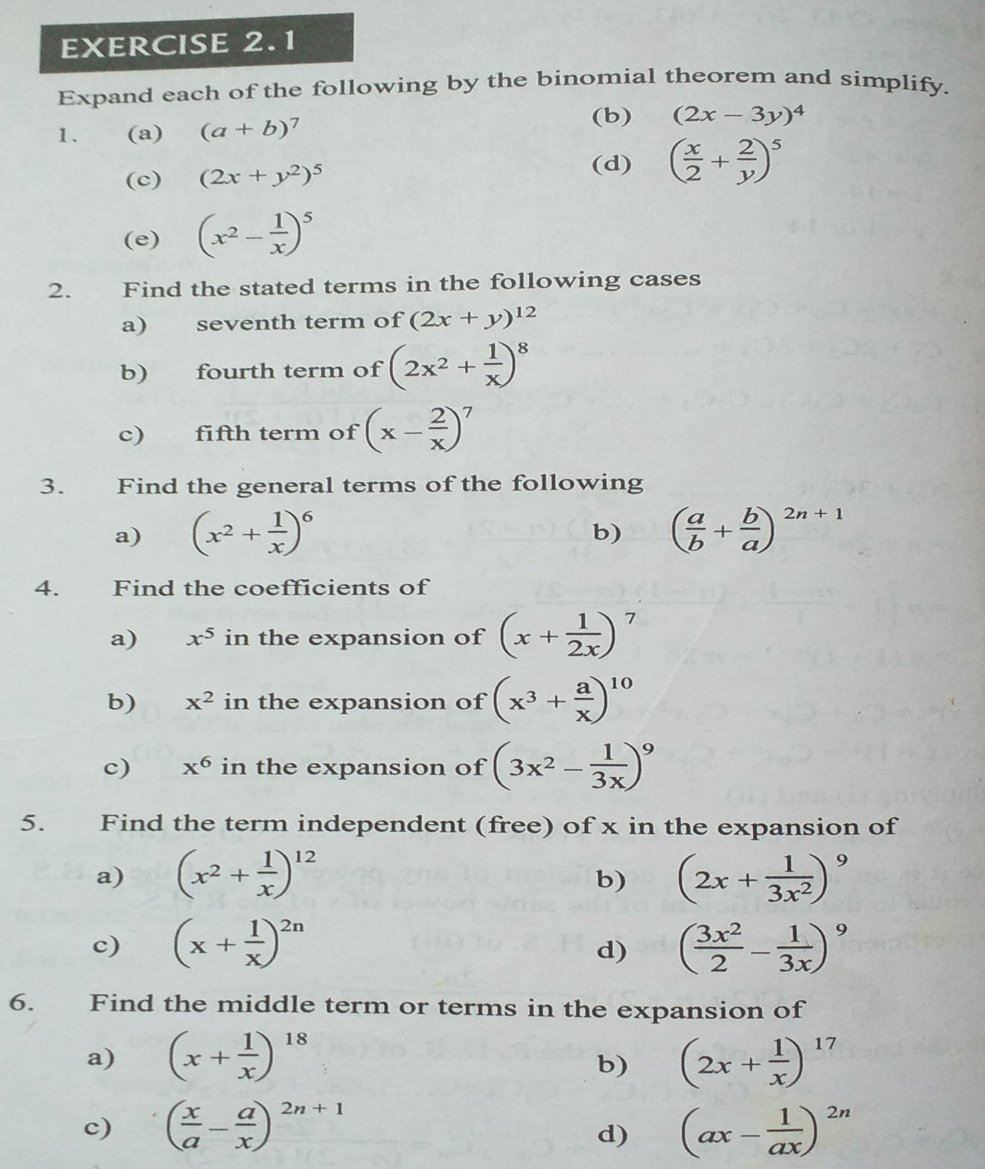

Slide 24
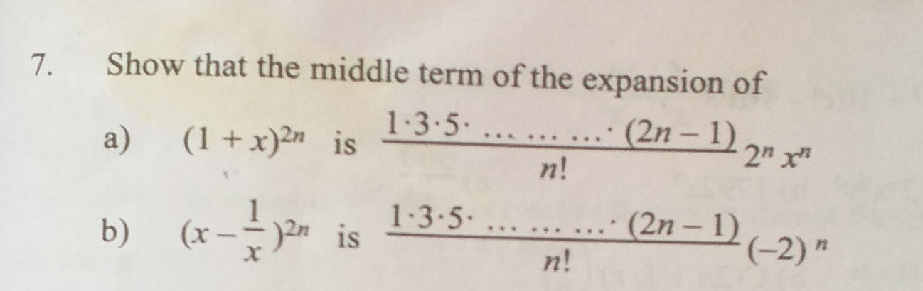
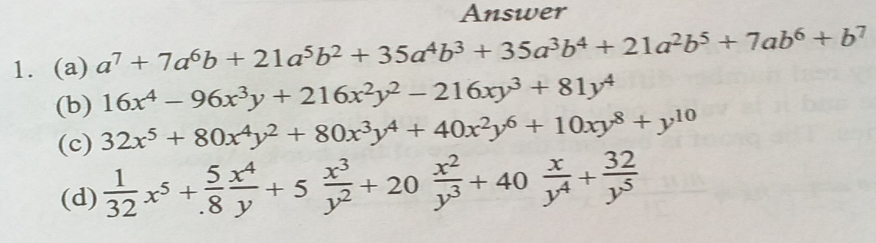
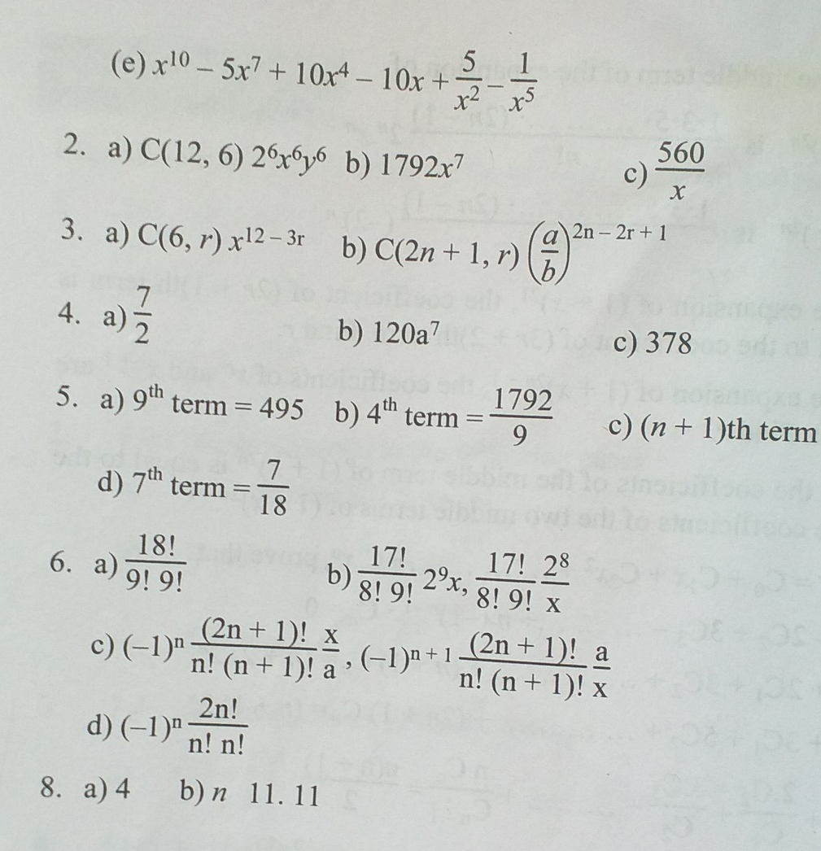

Slide 25
Properties of Binomial Coefficients
We know that for any positive integer ‘n’,
(1+x)^{n} = ^{n}c₀1 + ^{n}c₁.x + ^{n}c₂.x² +….+ ^{n}c_{r}.x^{r} +……+ ^{n}c_{n}.x^{n}
i.e. (1+x)^{n} = c_{o}+ c₁.x + c₂.x² +…. + c_{r}.x^{r} +.......+ c_{n}.x^{n}
where
c_{r}= ^{n}c_{r} , ^{n}c_{o}= ^{n}c_{n}= 1 are the binomial coefficients
1.The sum of the Binomial Coefficients is 2^{n} .
i.e. c_{o}+ c₁+ c₂+…… + c_{n}= 2^{n}
proof: we have,
(1 + x)^{n} = c_{o}1 + c₁.x + c₂.x² +…..+ c_{n}.x^{n}
putting x=1 on both sides we get
(1+1)^{n} = c_{o}+ c₁ + c₂ +…..+ c_{n}
c_{o}+ c₁+ c₂+…..+ c_{n} = 2^{n}

Slide 26
2. The sum of the coefficients of even numbered terms and the sum of the coefficients of odd numbered terms are equal and each is equal to 2^{n-1}.
i.e. c_{o} + c₂ + c₄ +……= c₁ + c₃+ c₅+……= 2^{n-1}
proof:
we know that
(1+x)^{n} = c_{o}+ c₁.x+ c₂.x²+…..+ c_{n}.x^{n} ………. i
Putting x=1 on both sides we get
(1+1)^{n} = c_{o}+ c₁+ c₂+…..+ c_{n}
⇒ c_{o}+ c₁+ c₂+…..+ c_{n} = 2^{n} .……………ii
Again putting x = -1 in equ^{n} (i) we get,
(1-1)^{n} = c_{o}- c₁+ c₂ -…..+ (-1)^{n} c_{n}
⇒ c_{o}- c₁+ c₂ -…..+ (-1)^{n} c_{n} = 0 ……………… iii
Adding equ^{n} (ii) and (iii) we get,
2c_{o}+ 2c₂+ 2c₄ …… = 2^{n}
⇒ c_{o}+ c₂+ c₄ …… = 2^{n}/2 = 2^{n-1} ……………. iv
Again subtracting (iii) from (ii) we get.
2c₁+ 2c₃+ 2c₅ …… = 2^{n}
⇒ c₁+ c₃+ c₅ …… = 2^{n}/2 = 2^{n-1} ……………... v
Hence from (iv) and (v)
c _{o}+ c₂ + c₄ +…… = c₁ + c₃ + c₅ +……= 2^{n-1}

Slide 27
3. c₁ + c₂ +…… + c_{n}= 2^{n} -1
proof:
we know that
(1+x)^{n} = c_{o}+ c₁.x+ c₂.x²+…..+ c_{n}.x^{n}
putting x = 1 on both sides we get
(1+1)^{n} = c_{o}+ c₁+ c₂+…..+ c_{n}
⇒ c_{o}+ c₁+ c₂+ c₃ …..+ c_{n} = 2^{n}
⇒ 1+ c₁+ c₂+ c₃ …..+ c_{n} = 2^{n}
c₁+ c₂+ c₃ …..+ c_{n} = 2^{n} -1

Slide 28
Pascal’s Triangle:
The coefficient of the successive powers of (a+b) can be arranged in triangular array of numbers called Pascal’s Triangle.
Example:
(a+b)⁰ = 1
(a+b)¹ = a + b
(a+b)² = a² + 2ab +b²
(a+b)³ = a³+ 3a²b + 3ab² + b³
(a + b)⁴ = a⁴+ 4a³b + 6a²b² + 4ab³ + b⁴
(a + b)⁵ = a⁵+ 5a⁴b + 10a³b² + 10a²b³ + 5ab⁴ + b⁵

Slide 29
Coefficients of the above expressions in Pascal’s Triangle form.
1
(a+b)⁰
1
+
1
(a+b)¹
1
+
2
+
1
(a+b)²
1
+
3
+
3
+
1
(a+b)³
1
+
4
+
6
+
4
+
1
(a + b)⁴
1
5
10
10
5
1
(a + b)⁵

Slide 30
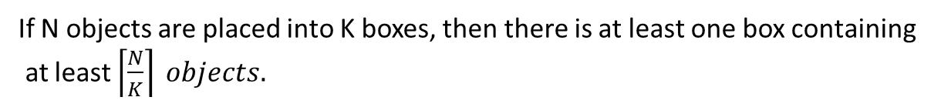
Pigeonhole Principle:
If ‘n’ pigeonholes are occupied by ‘n + 1’ or more pigeons, then at least one pigeonhole is occupied by more than one pigeon.
Generalized Pigeonhole Principle:
If ‘n’ pigeonholes are occupied by ‘kn + 1’ or more pigeons, where ‘k’ is a positive integer, then at least one pigeonhole is occupied by ‘k + 1’ or more pigeons.
If N objects are placed into K boxes, then there is at least one box containing
at least $\left\lceil \frac{N}{K}\right\rceil objects.$
Example 1:
Find the minimum number of students in a class to be sure that three of them are born in the same month.
Solution:
Here, n = 12 month are the pigeonholes and k+1=3 or k=2. Hence, kn + 1=2 × 12 +1 = 25 students (pigeons) three of them are born in same month.

Slide 31
Example 2:
Show that if any five integers from 1 to 8 are chosen, then at least two of them will have a sum 9.
solution:
Let, A= {1,2,….8}. The different subsets, each containing two numbers whose sum is equal to 9 are
A₁ ={1,8},
A₂ ={2,7},
A₃ ={3,6},
A₄={4,5}.
Each of the five number chosen from 1 to 8 must belong to one of these sets. The four sets as pigeonhole and five chosen numbers as pigeon.
Since, 4<5 i.e. the number of pigeonhole is less than the number of pigeons, by pigeonhole principle we can conclude that two of selected numbers must belong to the same set whose sum is 9.
The inclusion-exclusion Principle:
Let A and B are any finite sets, then
n(AυB) = n(A) + n(B) – n(A∩B)
Here, include n(A) and n(B) and exclude n(A∩B).
This relation is known as inclusion and exclusion Principle.

Slide 32
Problem Set:
Prove that:
i. n!(n+2)= n!+(n+1)!
ii. P(n,r) = (n-r+1) P(n , r-1)
iii. r.C(n,r) =n.C(n-1,r-1)
2. i. C(2n,3) :C(n,3)= 11:1 find n.
ii. If there are 12 persons in a party, if each of them handshakes with each other. How many handshakes happen in the party?
iii. If ^{m+n} P₂ =56 and ^{m-n} P₂ =12 find m and n.
3. i. Find the coefficient of x⁶ y³ in (x+y)⁹
ii. What is the coefficient of x⁵ y⁷ in (x-2y)¹² ?
iii. What is the coefficient of x³ y² in (3x-y)⁵ ?

Slide 33
4. A computer password consists of a letter of alphabet followed by 3 or 4 digits. Find
a. the total number of passwords that can be formed
b. the total number of passwords in which no digit repeats.
5. Find the minimum number of students needed to guarantee that five of them belong to the same class(Freshman, Sophomore, Junior, Senior).
6. Find the minimum number n of integer to be selected from S = {1, 2, …, 9} so that (a) the sum of two of the n integers is even, (b) the difference of two of the n integers is 5.

Slide 34
Recurrence relation:
Definition:
A recurrence relation for the sequence {a_{n}} is an equation that expresses a_{n} in
terms of one or more of the previous terms of the sequence, namely, a₀,a₁,…a_{n – 1},
for all integers n with n ≥ n₀, where n₀ is a nonnegative integer. A sequence is called
a solution of a recurrence relation if its terms satisfy the recurrence relation.
Order of recurrence relation
Order of recurrence relation is the difference between the largest and the smallest argument occurring in the difference equation.
Example:
Order of the recurrence relation y_{t+1} – 1.2y_{t} = 0 is one, as t +1 – t = 1
Similarly order of the recurrence relation y_{t+2} – ay_{t+1}+ by_{t} = 0 is 2, as t + 2 – t = 2
order of the recurrence relation y_{t+1} – ay_{t} – ₁ = by_{t} – ₂ is of order 3, as (t +1) – (t – 2) = 3

Slide 35
Definition:
A solution to a recurrence relation gives the value of x_{n}​ in terms of n, and does not require the value of any previous terms.
Example: Solve recurrence relation a_{n} = a_{n – 1} + 3, subject to the initial condition a₁ = 2.
solution:
Here,
a_{n} = a_{n – 1} + 3,
a₁ = 2
a₂ = a₁ + 3 = 2 + 3
a₃ = a₂ + 3 = 2 + 3 + 3 = 2 + 2(3)
a₄ = a₃ + 3 = 2 + 3 + 2(3)= 2 + 3(3)
… … … … … … … … … … … …
… … … … … … … … … … … …
a_{n} = 2 + 3(n – 1) is the general solution of the given recurrence relation

Slide 36
Example: Find the recurrence relation of the sequence 1, 3, 7, 15, 31, 63, … … …
Solution:
Here, a₁ = 1
a₂ = 2×1 + 1 = 2a₁ + 1
a₃ = 2×3 + 1 = 2a₂ + 1
a₄ = 2×7 + 1 = 2a₃ + 1
… … … … … … … … …
… … … … … … … … …
a_{n} = 2 a_{n – 1} + 1
Hence, the recurrence relation is a_{n} = 2 a_{n – 1} + 1, n > 1, a₁ = 1.
Linear Recurrence Relations
A linear recurrence relation is an equation that defines the n^{th} term in a sequence in terms of the k previous terms in the sequence. The recurrence relation is in the form:
x_{n}​ = c₁​x_{n−1}​ + c₂​x_{n−2​} +⋯+ c_{k}​x_{n−k}​
Where each c_{i​} is a constant coefficient.

Slide 37
How to find the characteristic equation of linear recurrence relation:
Given a recurrence relation a_{n} + αa_{n−1} + βa_{n−2} = 0 ……..(i)
Let a_{n} = r^{n} is a solution of equation (i), then, it must satisfy equation( i)
i.e. r^{n} + α r^{n} ⁻ ¹ + β r^{n −} ²= 0
Dividing by r^{n – 2} on both side we get,
or, r² + α r + β = 0
is known as characteristic equation of (i)
Case 1 If r₁ and r₂ are two distinct roots of the characteristic polynomial (i.e, solutions to the characteristic equation), then the solution to the recurrence relation is
a_{n} = a(r₁)^{n} + b(r₂)^{n},
Case 2 If the characteristic polynomial with only one root r (i,.e. r₁ = r₂). Then the solution to the recurrence relation is
a_{n} = a(r)^{n} + b.n(r)^{n},

Slide 38
Example:
Solve the recurrence relation Fn = 5Fn−1 − 6Fn−2 where F0 = 1 and F1 = 4
Solution: the given recurrence relation is Fn – 5Fn−1 + 6F_{n – 2} = 0
The characteristic equation of the recurrence relation is
r²− 5r+ 6 = 0,
So, (r−3)(r−2)=0
Hence, the roots are
r1 = 3 and r2 = 2
Hence, the required general solution is
F_{n} = a3^{n} + b2^{n}
………..(i)
When F0 = 1 and F1 = 4, then from equation (i)
F₀ = a3⁰ + b2⁰
⇒ 1 = a + b ………..(ii)
and F₁ = a3¹ + b2¹
⇒ 4 = 3a + 2b ………..(ii)
Solving equations (ii) and (iii), we get a = 2 and b = −1
Hence, the final solution is
F_{n}= 2.3^{n} + (−1).2^{n} = 2.3^{n} − 2^{n}

Slide 39
Non-Homogeneous Recurrence Relation and Particular Solutions
A recurrence relation is called non-homogeneous if it is in the form
F_{n} = AF_{n−1} + BF_{n−2} + f(n) where f(n)≠0
Its associated homogeneous recurrence relation is F_{n} = AF_{n–1} + BF_{n−2}
The solution (an) of a non-homogeneous recurrence relation has two parts.
First part is the solution (ah) of the associated homogeneous recurrence relation
and the second part is the particular solution (at).
Required solution of non-homogeneous recurrence relation is a_{n} = a_{h} + a_{t}
To find the particular solution, we find an appropriate trial solution.
Solution to the first part is done using the procedures discussed in the previous section.
To find the particular solution, we find an appropriate trial solution.

Slide 40
Let a non-homogeneous recurrence relation be Fn = AFn–1 + BFn−2 + f(n)
with characteristic roots x1 = 2 and x2 = 5. Trial solutions for different possible
values of f(n) are as follows −
f(n) | Trial solutions
4 | A
5.2^{n} | An2^{n}
8.5^{n} | An5^{n}
4^{n} | A4^{n}
2n²+3n+1 | An²+Bn+C
Example:
Solve the recurrence relation F_{n} = 3F_{n−1} + 10F_{n−2} + 7.5^{n} where F₀ = 4 and F₁ = 3
Solution
This is a linear non-homogeneous relation, where the associated homogeneous equation is
F_{n} = 3F_{n−1} + 10F_{n−2}
and f(n) = 7.5^{n}

Slide 41
The characteristic equation of its associated homogeneous relation is
r²− 3r − 10 = 0,
or, r²− 5r + 2r − 10 = 0,
So, (r−5)(r+2) =0
Hence, the roots are
r₁ = 5 and r₂ = − 2
Hence,
a_{h} = a.5^{n} + b.(− 2 )^{n}
where a and b are constants
Since f(n) = 7.5^{n}, trial solution of at will be A_{n}x^{n}
a_{t} = A_{n}x^{n} = A_{n}5^{n}

Slide 42

Thank You

